Slide 1

Software Quality Assurance
Assignment 01
Unit testing with Junit
This Photo by Unknown Author is licensed under CC BY-SA-NC

Slide 2

Group Details Group ID –2022-SQA-G32 Lanerolle T.Y –IT18540536 Prashadika W.M.J – IT18218572 Kumarasiri T.S.N – IT18222982 Wickramasinghe W.A.P.C -IT18062120

Slide 3
Student Registration Management System

Slide 4
SRMS - Functions
Login Management
Student Management
Payment Management
Subject Management
Attendance Management
Exam Management
Result Management
Class Management
Teacher Management

Slide 5
IT18540536 – Lanerolle T.Y
Subject Management
Payment Management

Slide 6
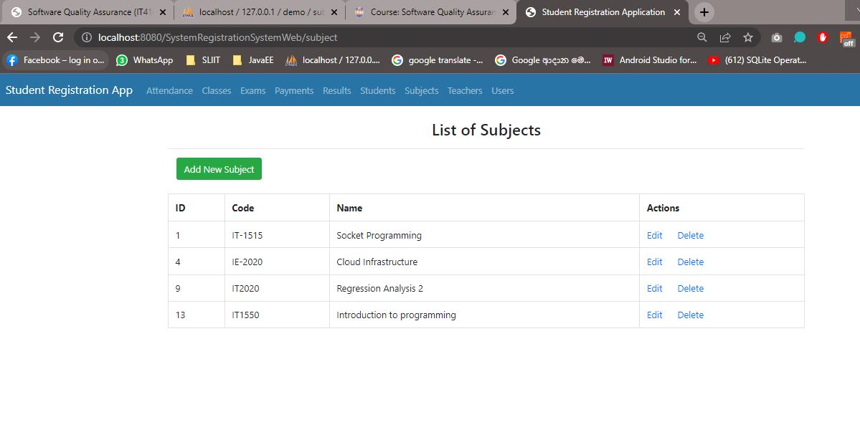
Subject Management

Slide 7
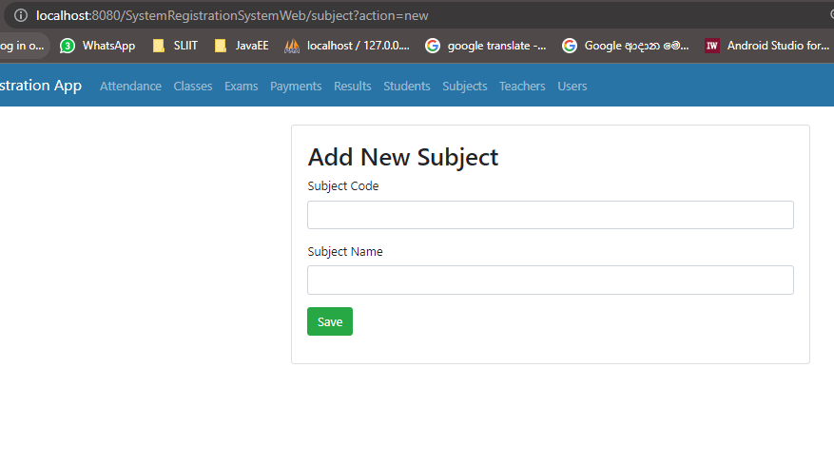
Subject Management – Add Subject

Slide 8
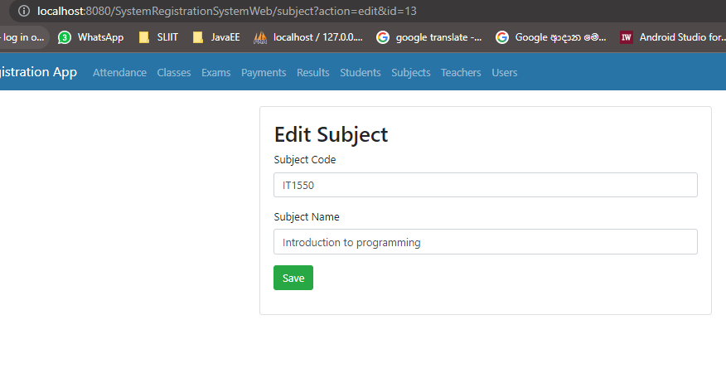
Subject Management – Edit Subject

Slide 9
Function 01 - Subject Management Test Plan
Test Scenario / Description | Test Input | Expected Output
1. Verify the user can create a subject. | Subject Id: Auto Subject Name: Machine Learning Subject Code: IT2024 | 1. User should be able to enter the Subject details to the system. 2. Inserted record should be visible in the grid.
2.Verify the required fields on 'Add Subject' screen. | Subject Name: Keep empty Subject Code: Keep empty | Should not be able to add subject entries with empty inputs.
3.Verify the user can view the subject details after save the subject information. | Not applicable | 1. User should be able to see the subject details after user submitting the subjects’ information. 2. The list should be sorted according to the add date
4.Check that the user can update the subject details by clicking the edit button. | Subject ID: 9 Subject Name: Regression Analysis Subject Code: IT2023 | Users should be able to update Subject details with valid inputs.
5. Verify the user can select the subject using edit option. | Subject ID: 9 | Correct subject details should appear according to the subject id.
6. Check that user can view all user details in the List of subject grid. | Not applicable | User should be able to view all the subjects.
7. Verify the user cannot add the same subject code multiple times. | Subject ID: 9 Subject Name: Regression Analysis Subject Code: IT2020 | User should not be able to add duplicate subject codes.
8. Check that user can only add subject codes with character count 6. | Subject ID: Auto Subject Name: Regression Analysis Subject Code: IT20200 | User should be able to add subject codes with character count 6.
9. Verify the user only can delete an existing subject entry. | Subject Id: 999 | User should be able to delete existing subjects.
10. Verify the user only can select an existing subject entry. | Subject Id: 999 | User should be able to select existing subjects.

Slide 10
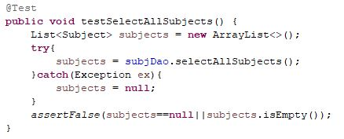
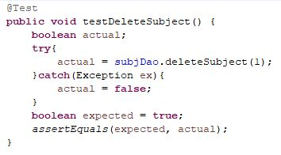
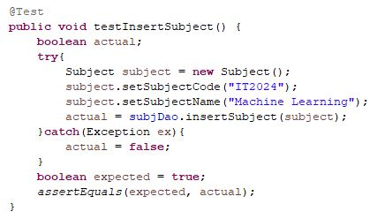
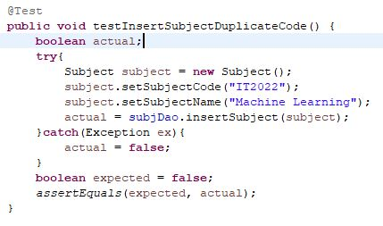
Junit Test Cases For Subject Management

Slide 11
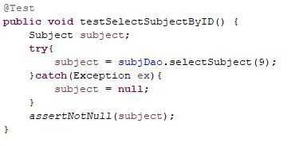
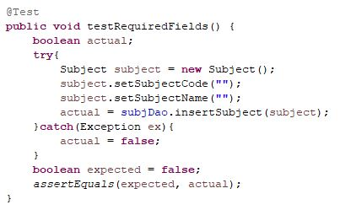
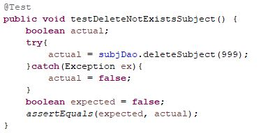
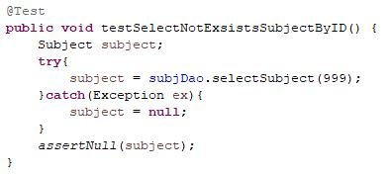
Junit Test Cases For Subject Management

Slide 12
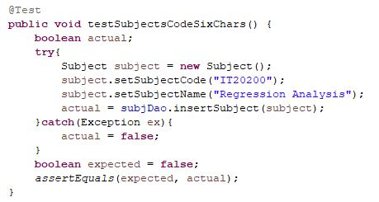
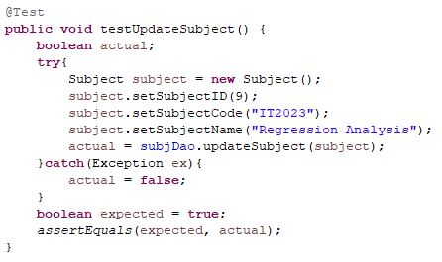
Junit Test Cases For Subject Management

Slide 13
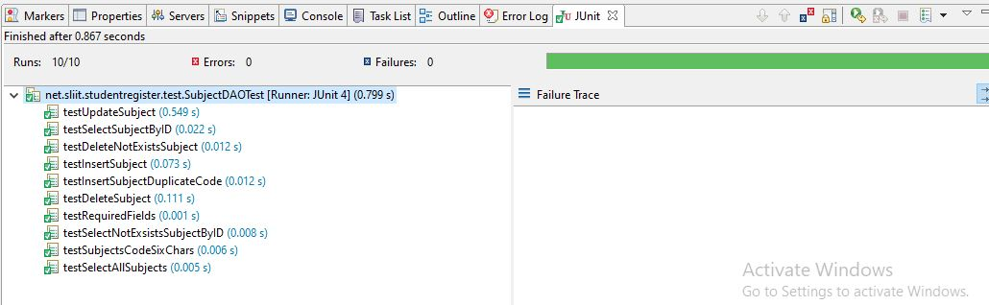
Test Results from Subject Management Test Cases

Slide 14
Conclusions of the Testing
Observed all the functions are working as expected.
All the identified test scenarios has been covered.
All the test cases gave the expected outcomes.
All the functionalities are working as expected according to the test results.

Slide 15
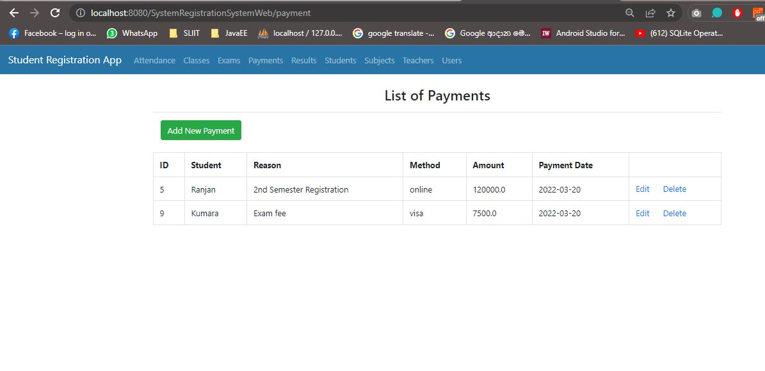
Payment Management

Slide 16
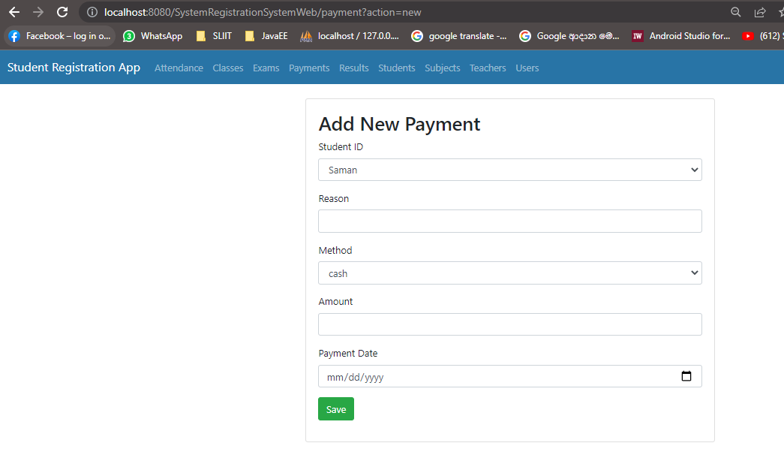
Payment Management – Add Payment

Slide 17
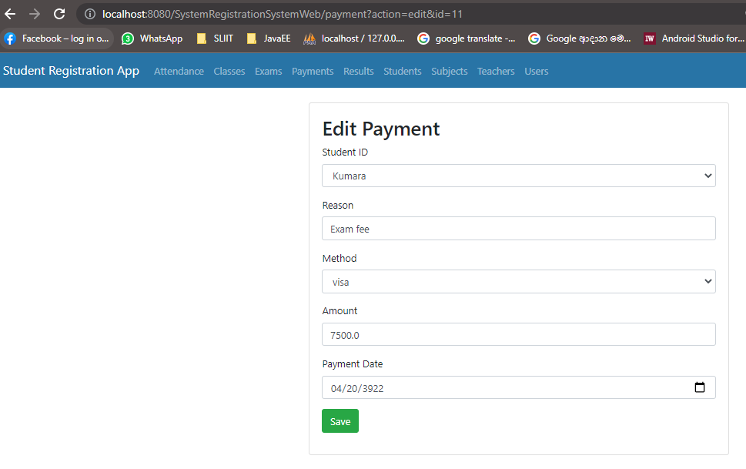
Payment Management – Edit Payment

Slide 18
Function 02 - Payment Management Test Plan
Test Scenario / Description | Test Input | Expected Output
1. Verify the user can enter a payment. | Payment Id: Auto Student Id: 13 Reason: Registration Method: visa Amount – 1000000 Payment Date – 2022-03-20 | 1. User should be able to enter the payment details to the system. 2. Inserted Payment should be visible in the grid.
2. Verify the required fields on 'Add Payment' screen. | Student Id: Keep empty Reason: Keep empty Method - Keep empty Student Last Name - Keep empty Amount - Keep empty Payment Date - Keep empty | User should not be able to add subject entries with empty inputs.
3. Verify the user cannot enters an invalid amount. | Amount - -99 | User should not be able to insert payment with invalid amount to the system.
4. Verify the user cannot enter greater than 1 million in a single payment. | Amount - 2000000 | User should not be able to insert a payment with amount more than 1 million.
5. Verify the user can view the student payment details after submitting payment details. | Not applicable | 1. User should be able to see the payment details after user submitting a new payment entry. 2. The list should be sorted according to the payment Id.
6. Check that the user can select the payment details using edit option. | Payment Id: 9 | User should be able to see the payment details that relates to the selected entry.
7. Check that the user can update the payment details by clicking the edit button. | Payment Id: 9 Student Id: 13 Reason: Registration Amount - 7500 Payment Date – 2022-03-20 | 1. User should be able update payment details without receiving an error. 2. User should be able to view updated details from the List of payments grid.
8. Check that the user can delete the payment record by clicking the delete button. | Payment Id: 5 | User should be able to remove selected payment entry.
9. Verify the user can only delete existing payment entries. | Payment Id: 999 | User should only be able to delete existing payment entries.
10. Verify the user can only select existing payment entries. | Payment Id: 999 | User should only be able to select existing payment entries.

Slide 19
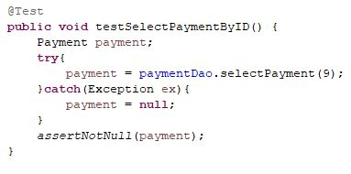
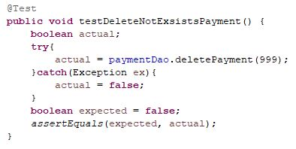
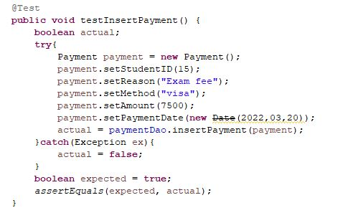
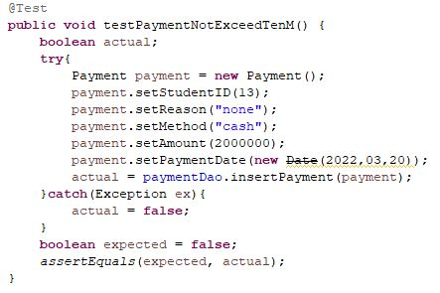
Junit Test Cases For Payment Management

Slide 20
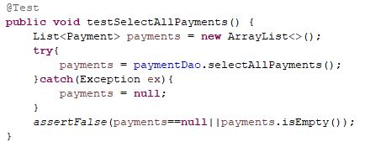
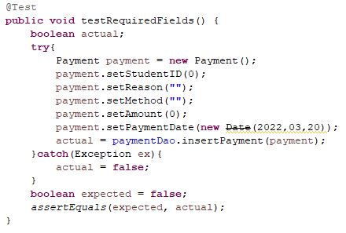
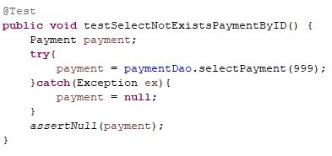
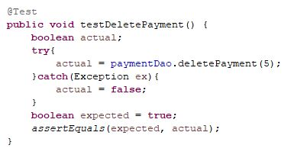
Junit Test Cases For Payment Management

Slide 21
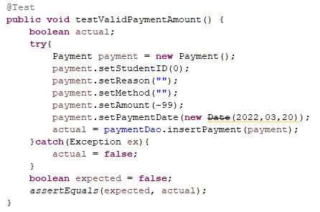
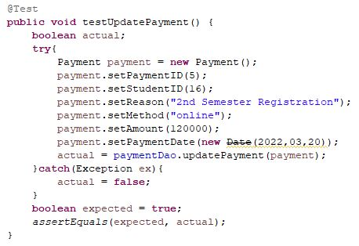
Junit Test Cases For Payment Management

Slide 22
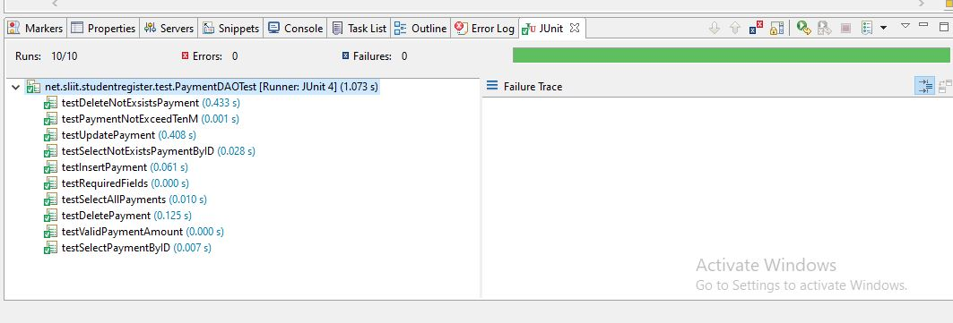
Test Results from Payment Management Test Cases

Slide 23
Conclusions of the Testing
Observed all the functions are working as expected.
All the identified test scenarios has been covered.
All the test cases gave the expected outcomes.
All the functionalities are working as expected according to the test results.

Slide 24
IT18218572 – Prashadika W.M.J
Exam Management
Result Management

Slide 25
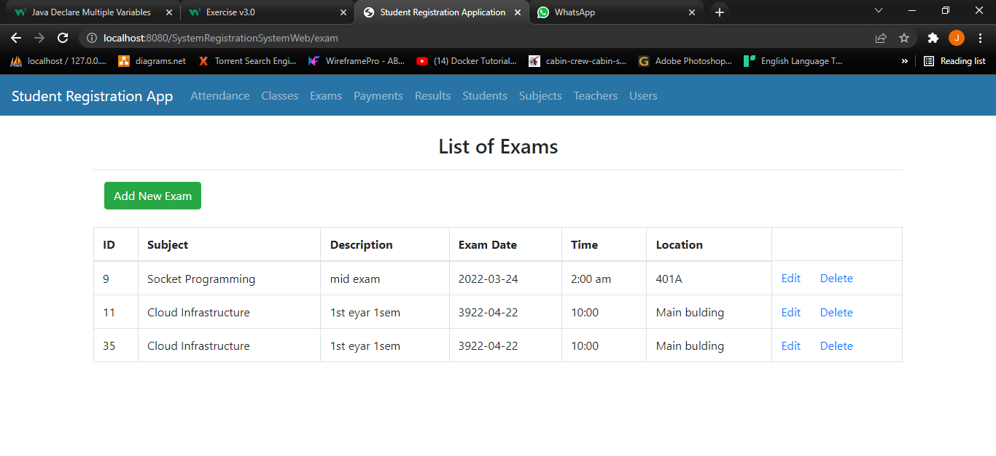
Exam Management

Slide 26
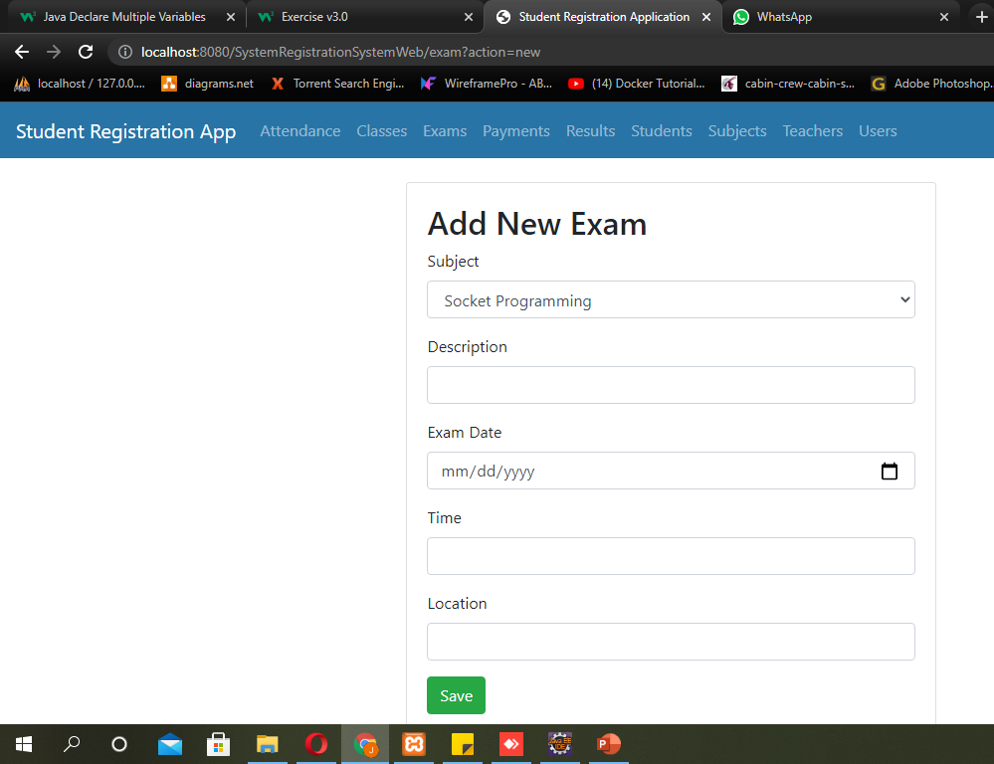
Exam Management – Add Exam

Slide 27
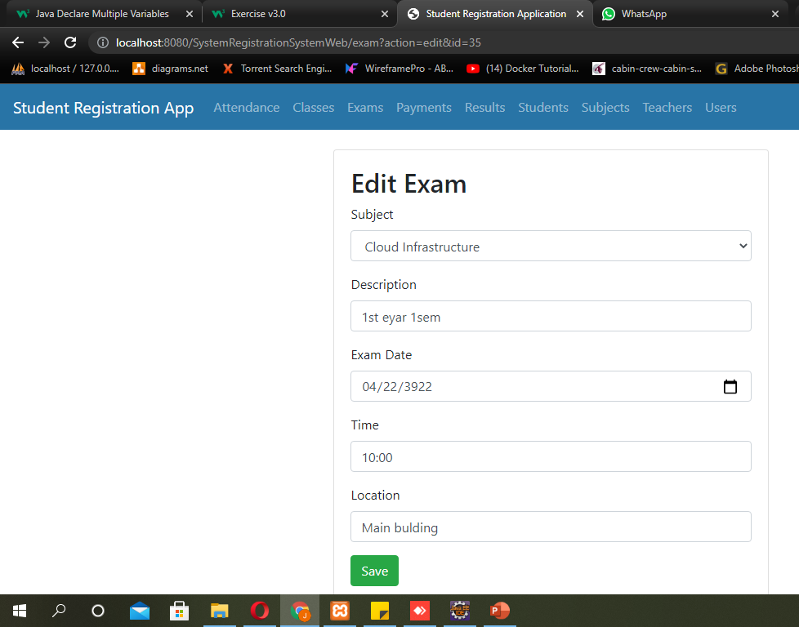
Exam Management – Edit Exam

Slide 28
Function 01 - Exam Management Test Plan
Test Scenario / Description | Test Input | Expected Output
1. Verify the user can create a Exam. | Exam Id: Auto SubjectId:4 Description Name: 1st year 1sem Exam Time:10:00 Exam Location: Main | 1. User should be able to enter the Subject details to the system. 2. Inserted record should be visible in the grid.
2. Verify the empty input on the 'Add Exam' screen. | Exam Id: Auto Subject Id:0 Description Name: null Exam Time: null Exam Location: null | Should not be able to add subject entries with empty inputs.

Slide 29
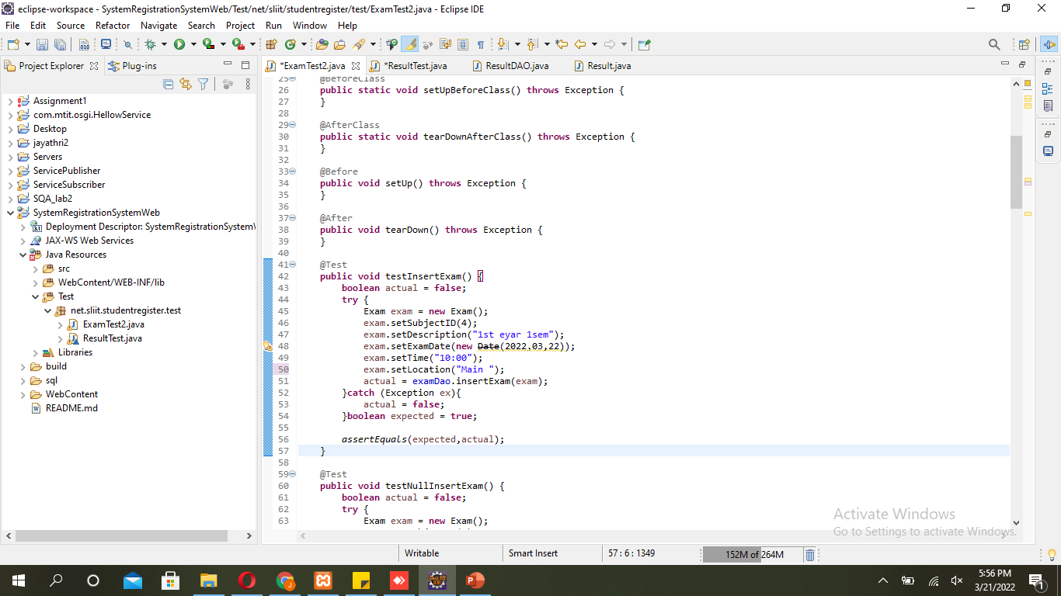
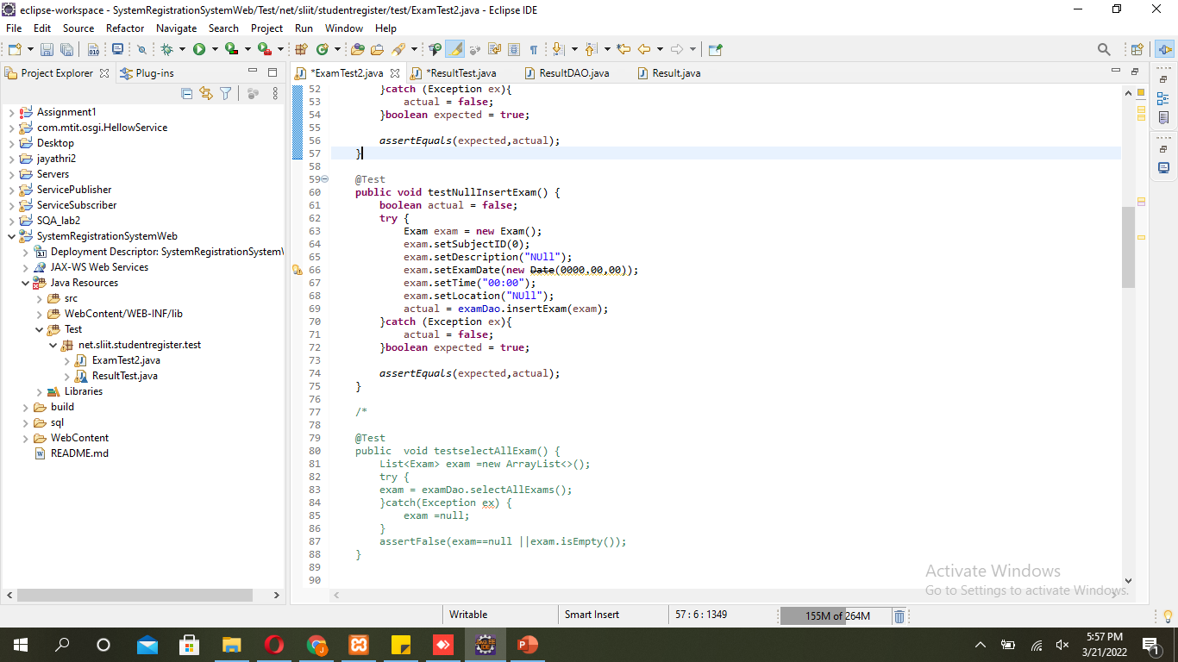
Junit Test Cases For Exam Management

Slide 30
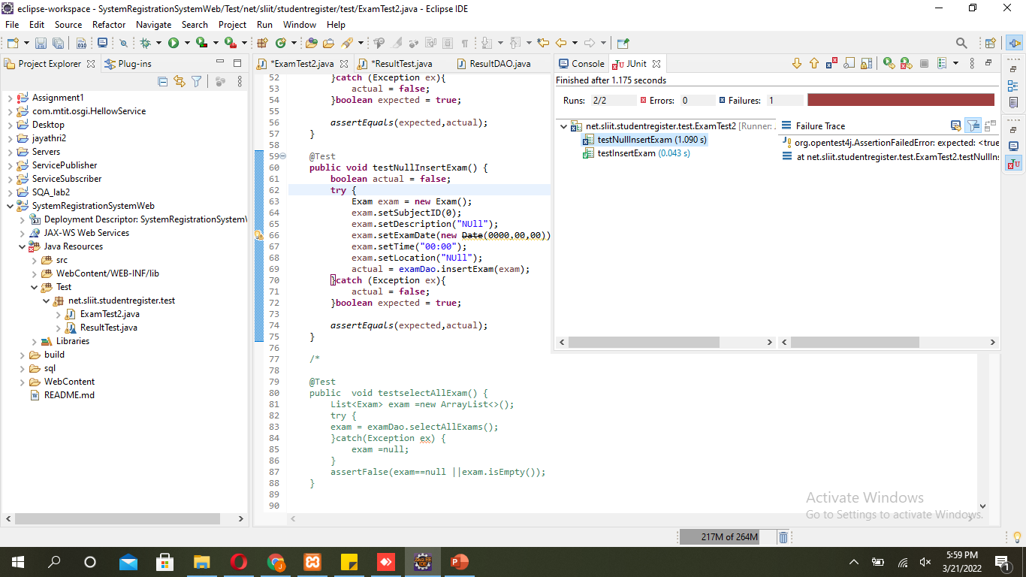
Test Results from Exam Management Test Cases

Slide 31
Conclusions of the Testing
Observed all the functions are working as expected.
All the identified test scenarios has been covered.
All the test cases gave the expected outcomes.
All the functionalities are working as expected according to the test results.

Slide 32
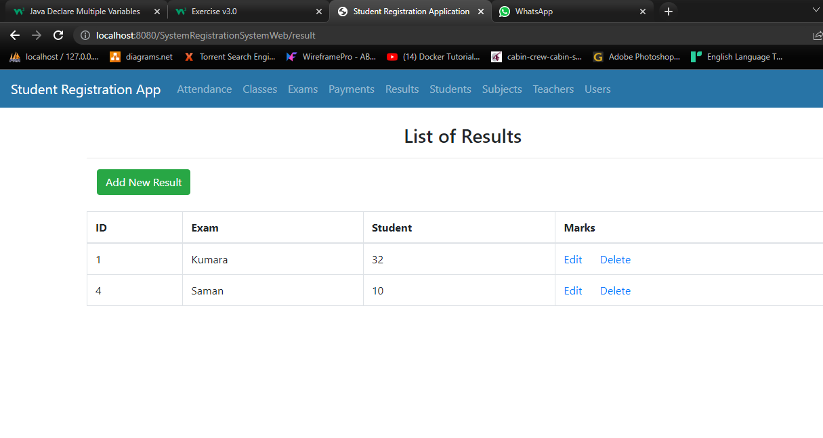
Result Management

Slide 33
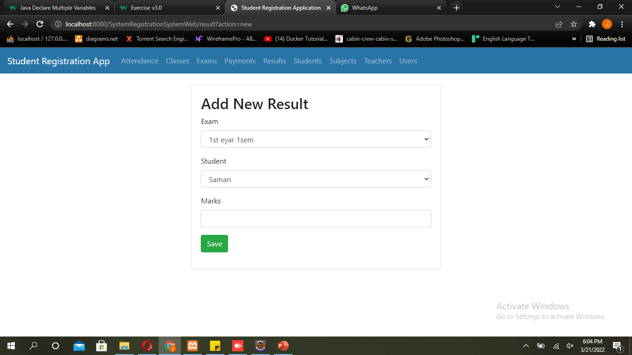
Result Management – Add Result

Slide 34
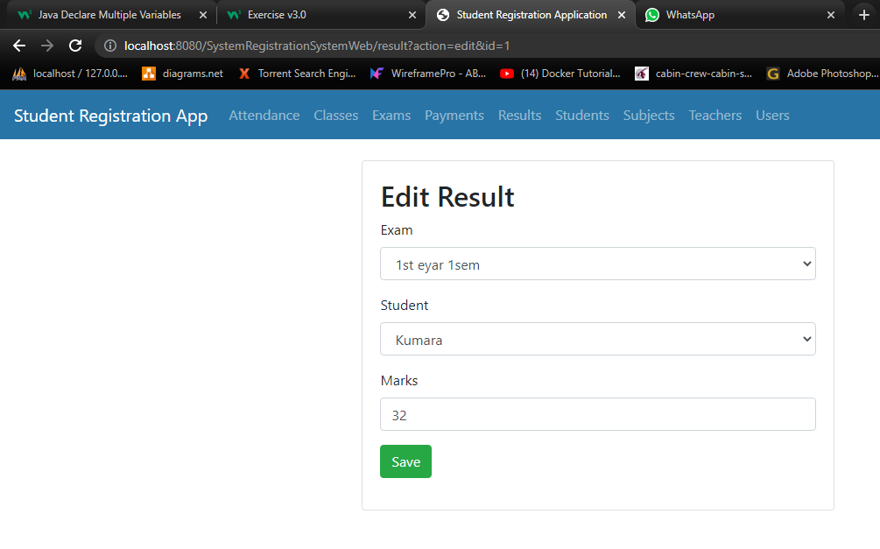
Result Management – Edit Result

Slide 35
Function 02 - Result Management Test Plan
Test Scenario / Description | Test Input | Expected Output
1. Check the setExamID method | Exam Id: 000 Expected:300 | Should get an error
2. Check the setExamID method using another input using | Exam Id: 100 Expected:100 | Give pass test
3. Check the test SetResultID method | Result Id:45 Expected :0 | User should not be able to insert with the invalid Id to the system.
4. Check the SetResultID method using another input using | Result Id:45 Expected:45 | Give pass test
5. Check the getStudetnID method | Student Id:45 Expected :30 | User should not be able to insert with the invalid Id to the system.
6. Chaek setmarks methos | Marks = 80 Marks = 80 | Give pass test
7.Test null adding | Student ID = 60; Result ID = 60; Marks = 80; expected = 0 ; | Should get an error
8.Test null adding another input using | Student ID = 20; Result ID = 0; Marks = 0; expected = 0 ; | Should get an error

Slide 36
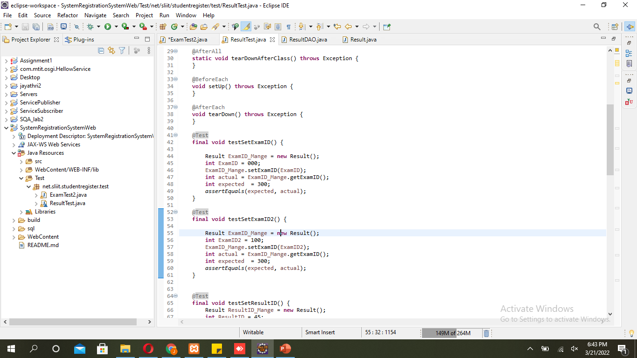
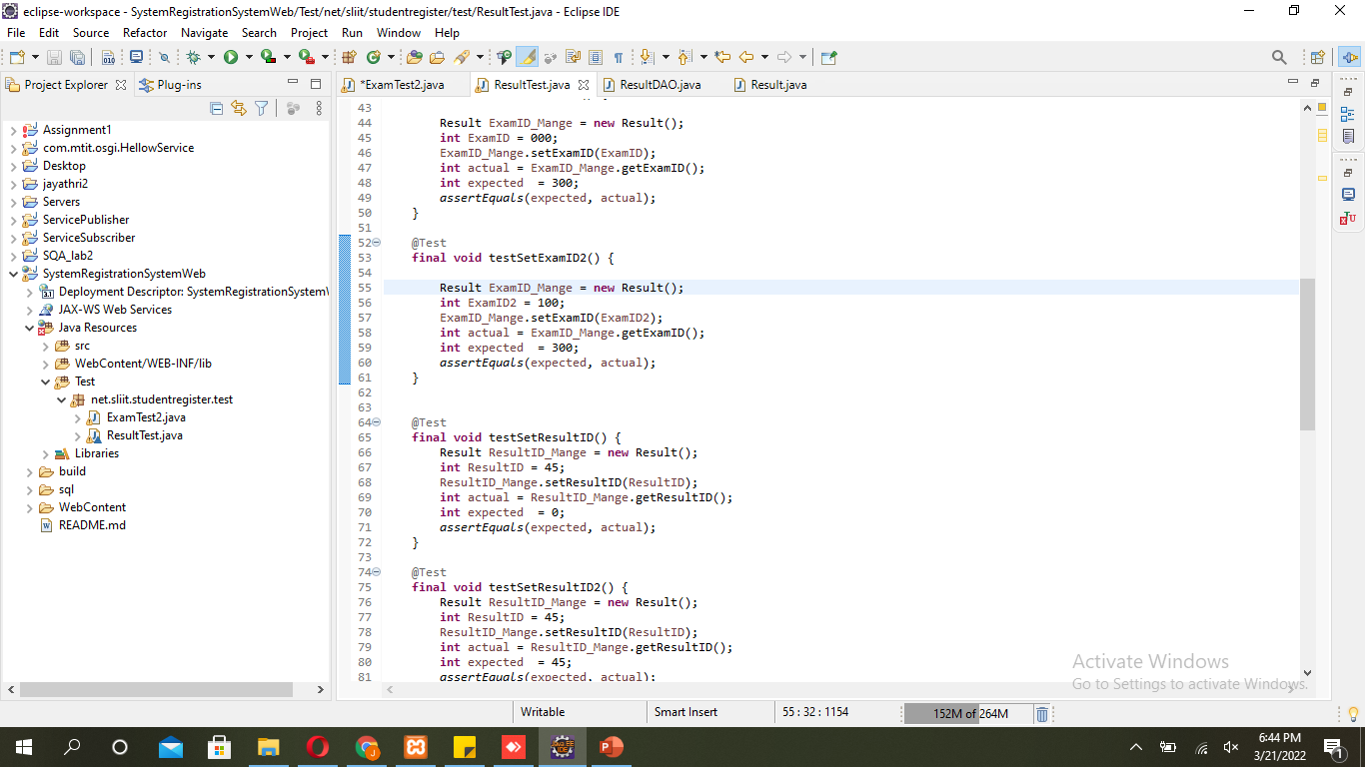
Junit Test Cases For Result Management

Slide 37
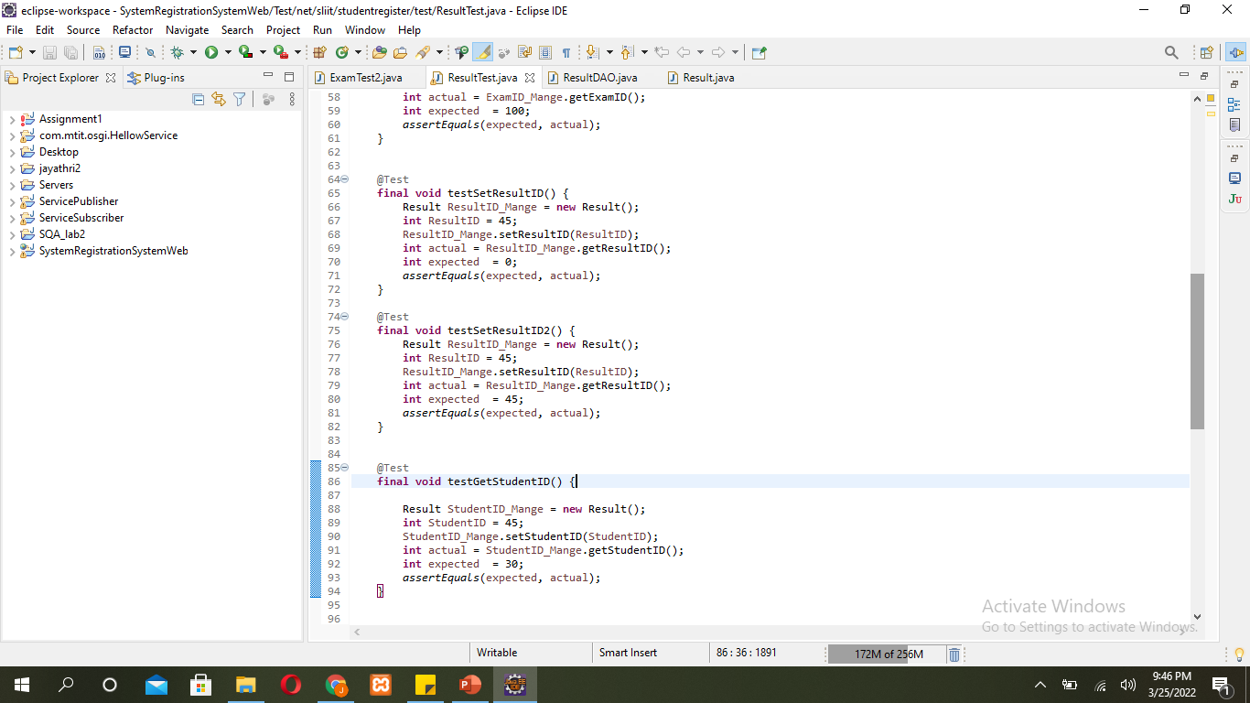
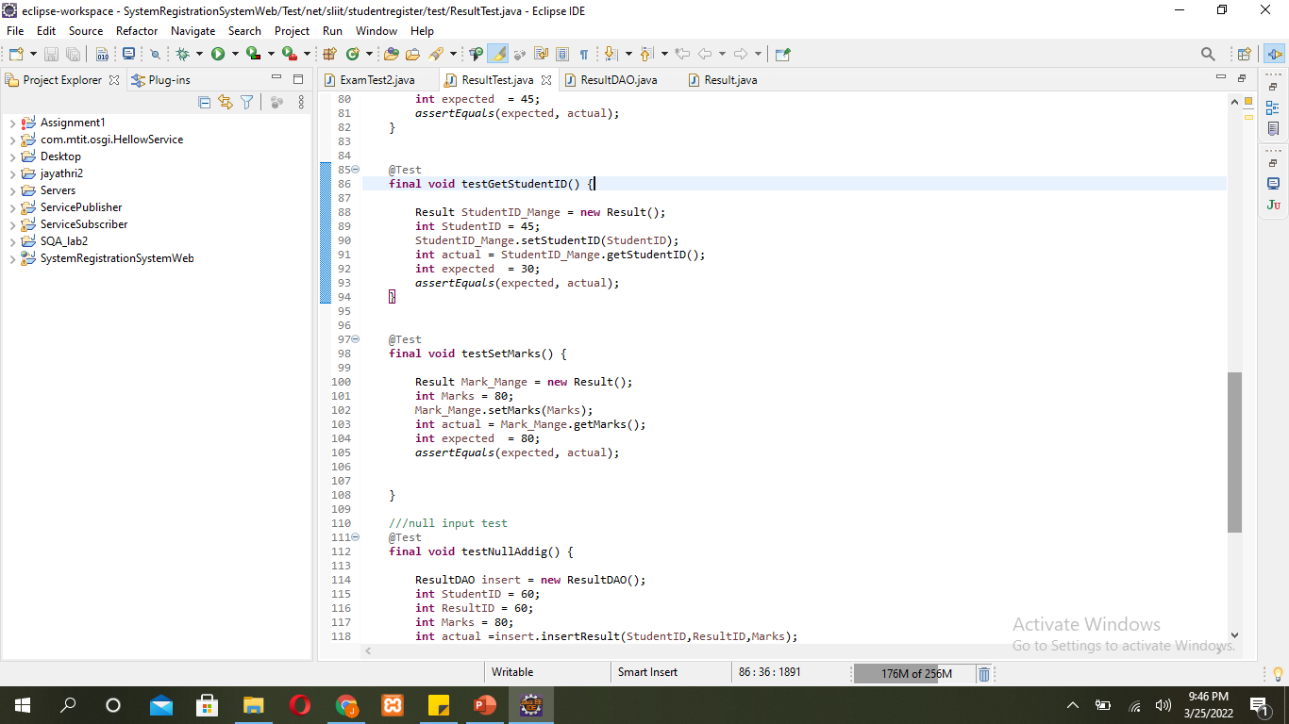
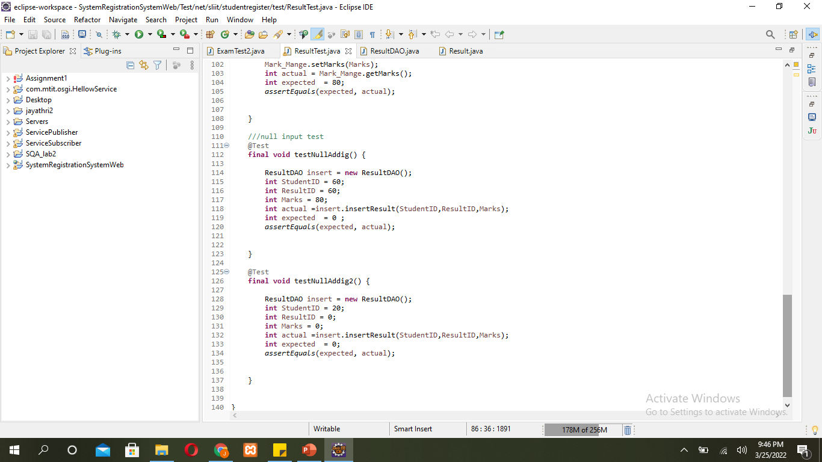
Junit Test Cases For Result Management

Slide 38
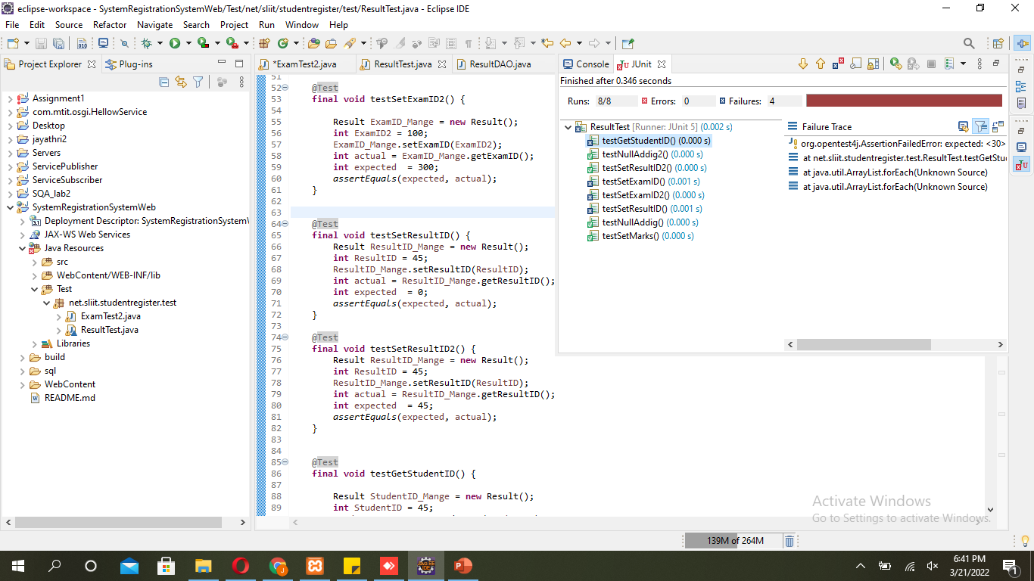
Test Results from Result Management Test Cases

Slide 39
Conclusions of the Testing
Observed all the functions are working as expected.
All the identified test scenarios has been covered.
All the test cases gave the expected outcomes.
All the functionalities are working as expected according to the test results.

Slide 40
IT18222982– Kumarasiri T.S.N
Student Management
Attendance Management

Slide 41
Test plans
ID | Test case name | Test case description | Test input | Expected output
1 | Student login | Able to verify student as a valid user | Username Password | Display student list view
2 | First name field validation | Insert the first name is required | null | Display “Please fill out this field” warning
3 | Insert student birthday | Insert birth day for student list | Date of birth | User should view student’s date of birth in student list.
4 | Search student | Able to search student ID by giving student name | Student name | Display corresponding student ID
5 | Insert email | Insert email for student list | Email address | User should view student’s email in student list.

Slide 42
Test plans
ID | Test case name | Test case description | Test input | Expected output
6 | Insert student ID | Insert student ID for attendance list | Student ID | User should view student’s ID in attendance list.
7 | Insert phone number | Insert phone number for attendance list | Phone number | User should view student’s phone number in attendance list.
8 | Insert attendance date | Insert attendance date for attendance list | Attendance date | User should view student’s attendance date in attendance list.
9 | Search attendance | Able to search student ID by giving class ID | Class ID | Display corresponding student ID
10 | Insert class ID | Insert class ID for attendance list | Class ID | User should view student’s class ID in attendance list.

Slide 43
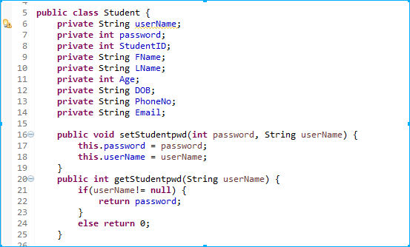
Key functions
1.Student login

Slide 44
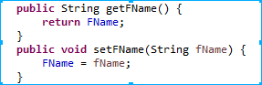
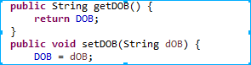
2.Insert student first name
3.Insert student birthday

Slide 45
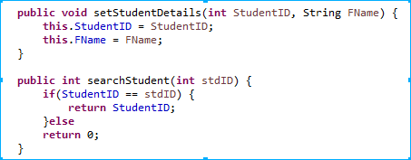
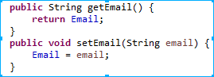
4.Search student
5.Insert email

Slide 46
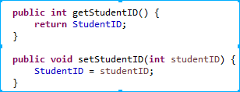
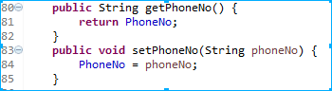
6.Insert student ID
7.Insert phone number

Slide 47


8.Insert attendance date
9.Search attendance

Slide 48

10.Insert class ID

Slide 49

Junit test cases
1.Student login

Slide 50


2.Insert student first name
3.Insert student birthday

Slide 51


4.Search student
5.Insert email

Slide 52


6.Insert student ID
7.Insert phone number

Slide 53


8.Insert attendance date
9.Search attendance

Slide 54

10.Insert class ID

Slide 55

Test result
When all test cases execute correctly

Slide 56

When all test cases execute correctly

Slide 57
Conclusion

Slide 58


When test cases do not execute correctly

Slide 59


When test cases do not execute correctly

Slide 60
IT18062120 – Wickramasinghe W.A.P.C
Login Management
Class Management
Teacher Management

Slide 61
Test Cases
ID | Test case description | Test procedure | Test input | Expected results | Actual results | Test results
01 | Test whether Admin Sign up is successful. | Enter the valid user name and password as input values | username = Nuwan , password = 1234 | username = Nuwan , password = 1234 | username = Nuwan password = 1234 | pass
02 | Test whether Teacher login successful or not. | Enter the valid Teacher details as input values | Teacher ID = 1. UName = Sachini, Password = 12345 | Teacher ID = 1. UName = Sachini, Password = 12345 | Teacher ID = 1. UName = Sachini, Password = 12345 . | pass
03 | Test whether Teacher login successful or not. | Enter the Invalid Teacher details as input values | Teacher ID = 1. UName = Sachinii, Password = 12345 | Teacher ID = 1. UName = Sachini, Password = 12345 | Teacher ID = 1. UName = Sachinii, Password = 12345 | fail
04 | Test whether Teacher salary successful or not. | Enter the valid Teacher salary details as input values Enter the same value for actual and expected value | Expected = full payment Actual = full payment | Expected = full payment Actual = full payment | Expected = full payment Actual = full payment | pass
05 | Test whether Teacher salary Details successful or not. | Enter the valid Teacher salary details as input values | Expected = full payment Actual = monthly payment | Expected = full payment Actual = monthly payment | Expected = full payment Actual = monthly payment | pass

Slide 62
ID | Test case description | Test procedure | Test input | Expected results | Actual results | Test results
06 | Test whether the class type is successful or not | Enter the same value for actual and expected value | Expected = Class A Actual = Class A | Class A | Class A | pass
07 | Test whether the class type is successful or not | Enter the same value for actual and expected value | Expected = Class B Actual = Class B | Class B | Class B | pass
08 | Test whether the class type is successful or not | Enter the same value for actual and expected value | Expected = Class C Actual = Class C | Class C | Class C | pass
09 | Test whether the class type is successful or not | Enter the different value for actual value | Expected = Class A Actual = Class B | Class A | Class B | fail
10 | Test whether the class type is successful or not | Enter the different value for actual value | Expected = Class A Actual = Class C | Class A | Class C | fail

Slide 63

Admin test cases
test cases 1

Slide 64

Admin test cases
test cases 2

Slide 65


Teacher Login details test cases
test cases 3
test cases 4

Slide 66


Teacher management test cases
test cases 5
test cases 6

Slide 67


Class details management test cases
test cases 7
test cases 8

Slide 68


Class details management test cases
test cases 9
test cases 10

Slide 69
THANK YOU..!

